Slide 1

IMS Project
Hamza Pervaiz

Slide 2
Introduction
About
Background in Computer Networks and Security. Previous experience with languages such as PHP, SQL, C+, HTML/CSS.
Project Approach
The project specification was initially analyzed from requirements to deliverables checklist.
Used IMS-Demo as base starting point to understand functionality and flow of the application.
Listed all requirements, user stories, acceptance criteria and prioritized using Moscow analysis. Utilization of Kanban to track and record (Jira/Trello). All completed prior to starting project implementation.

Slide 3
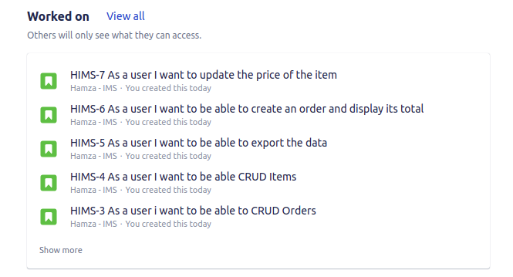
Planning – User Stories
Analysis of project specification, obtaining requirements and creating defined user stories with acceptance criteria.

Slide 4
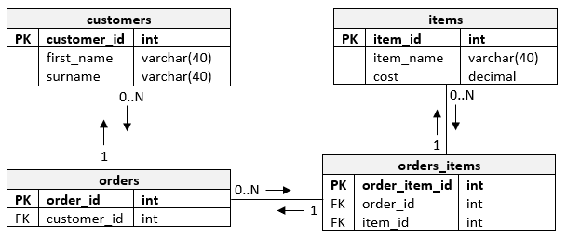
Planning - ERD
Use of ERD (Entity Relationship Diagram) for MySQL table structures.

Slide 5
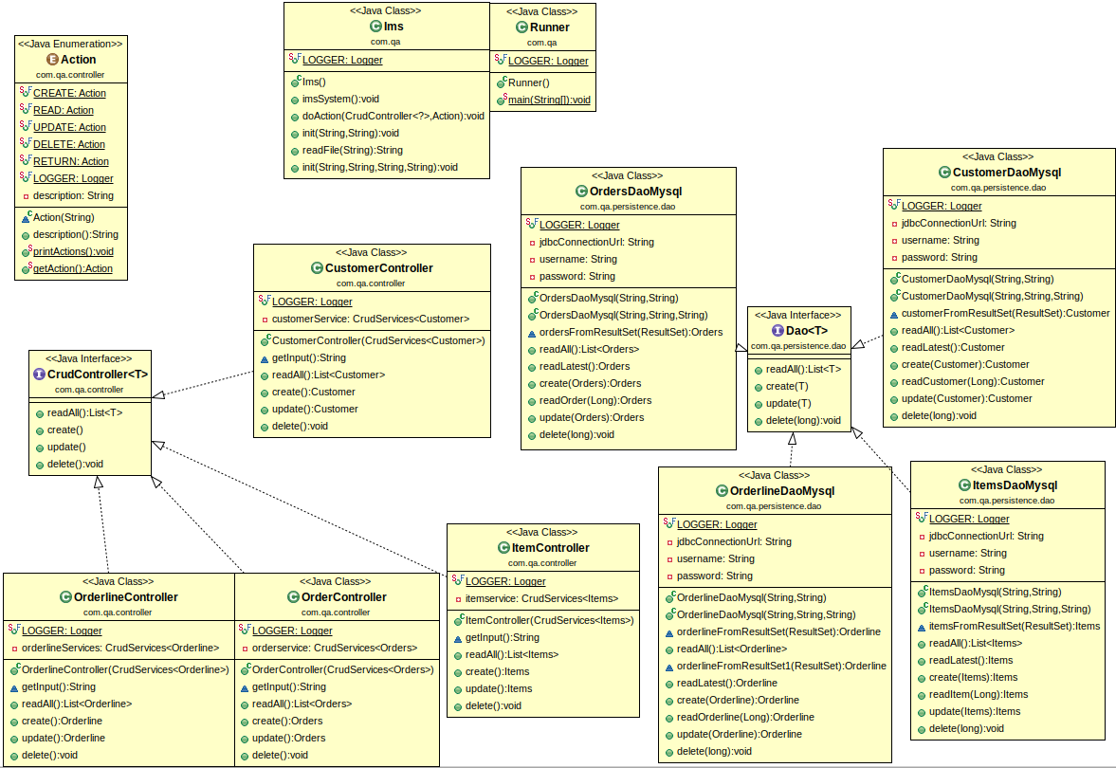
Planning - UML
Use of Unified Modelling Language Diagrams (UML) to understand flow of application.

Slide 6







Consultant Journey
Technologies learned and used for this project:
1. MySQL/Java
2. Junit and Mockito
3. GitHub and Eclipse
4. Maven
5. JDK runtimes / environments / PATH variables

Slide 7
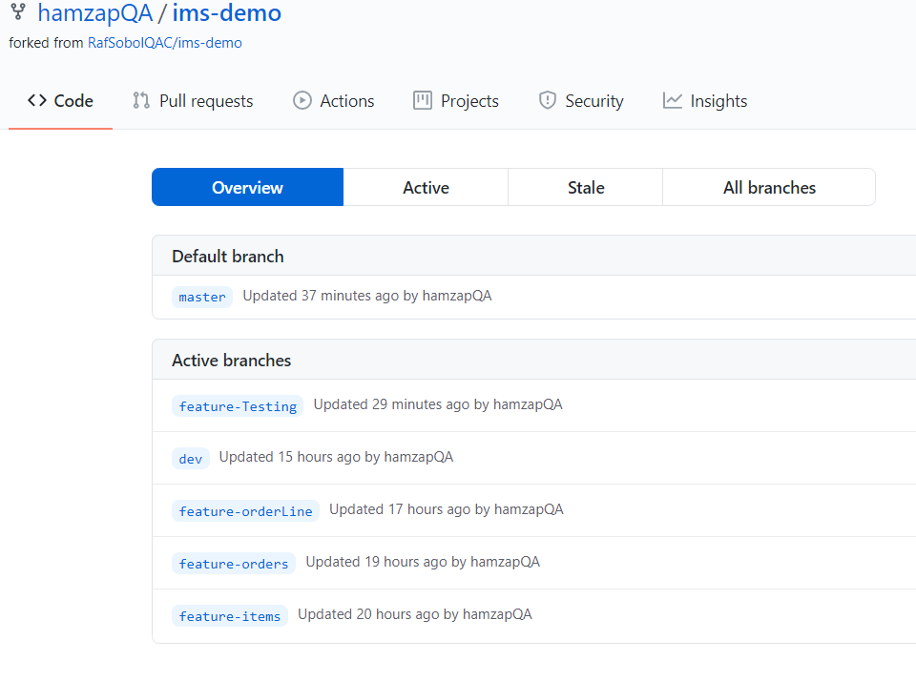
Continuous Integration/ Version Control
GitHub used for Version Control, using the feature-<concept> model. Features developed incrementally and added to each branch.
https://www.github.com/hamzapQA/ims-demo

Slide 8
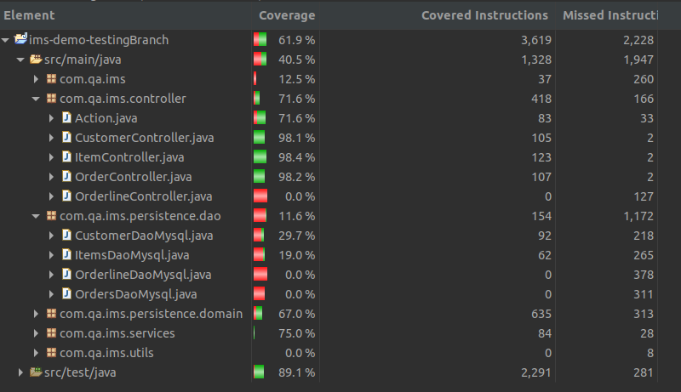
Testing
Tests carried out on following classes:
Customer, Items, Order (Domain)
Customer, Items, Order (Controllers)
Customer, Items, Order (DAO)

Slide 9
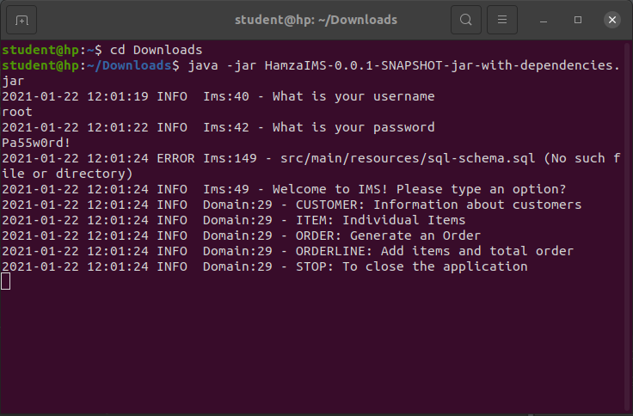
Demonstration
User Stories

Slide 10
Sprint Review
Completed:
CRUD functionality of Customers/Items/Orders + supporting documentation.
GitHub repo and branches used.
Codebase completed.
Fat JAR application which can be deployed via the command line.
Not completed:
- Order and OrderLine are separate classes – integration between the two.
- Further testing.
- GCP MySQL instance integration.

Slide 11
Sprint Retrospective
IMS-Demo starting point helped a lot as it allowed to understand initial functionality.
GitHub version control helped to easily revert to amend errors.
Access to recorded material on MS Teams helped.
Could Improve:
Logger – Condense console output.
IMS – Add help screens to assist users.
IMS – Add export functionality to export SQL data.
IMS – Create a more user friendly UI.
Security – Confidentiality / Integrity / Availability of application.
Encryption – logging into DB.
Techniques to mitigate vulnerabilities in code (SQL injections etc.) and make code secure.

Slide 12
Conclusion
Project overall was a success as acceptance criteria met.
Technologies and experiences learned will be valuable when developing new applications.
Now aware of SFIA 7 framework
Project allowed understanding of how to plan future projects, (requirements, time management, resources).
Will continue building on project in spare time as a hobby to deepen knowledge and improve functionality.

Slide 13
Thank You

